Slide 1
La IA aplicada a la red del campus
#AI + #Wireless + #Wired + #SDWAN = #AI Driven Enterprise
José Fidel Tomás
AIDE Specialist Consulting Engineer – EMEA
fidel.tomas@juniper.net
#MARVIS

Slide 2
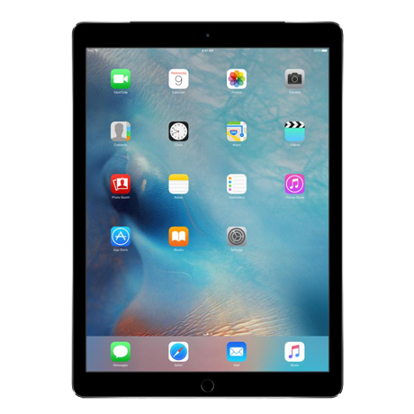
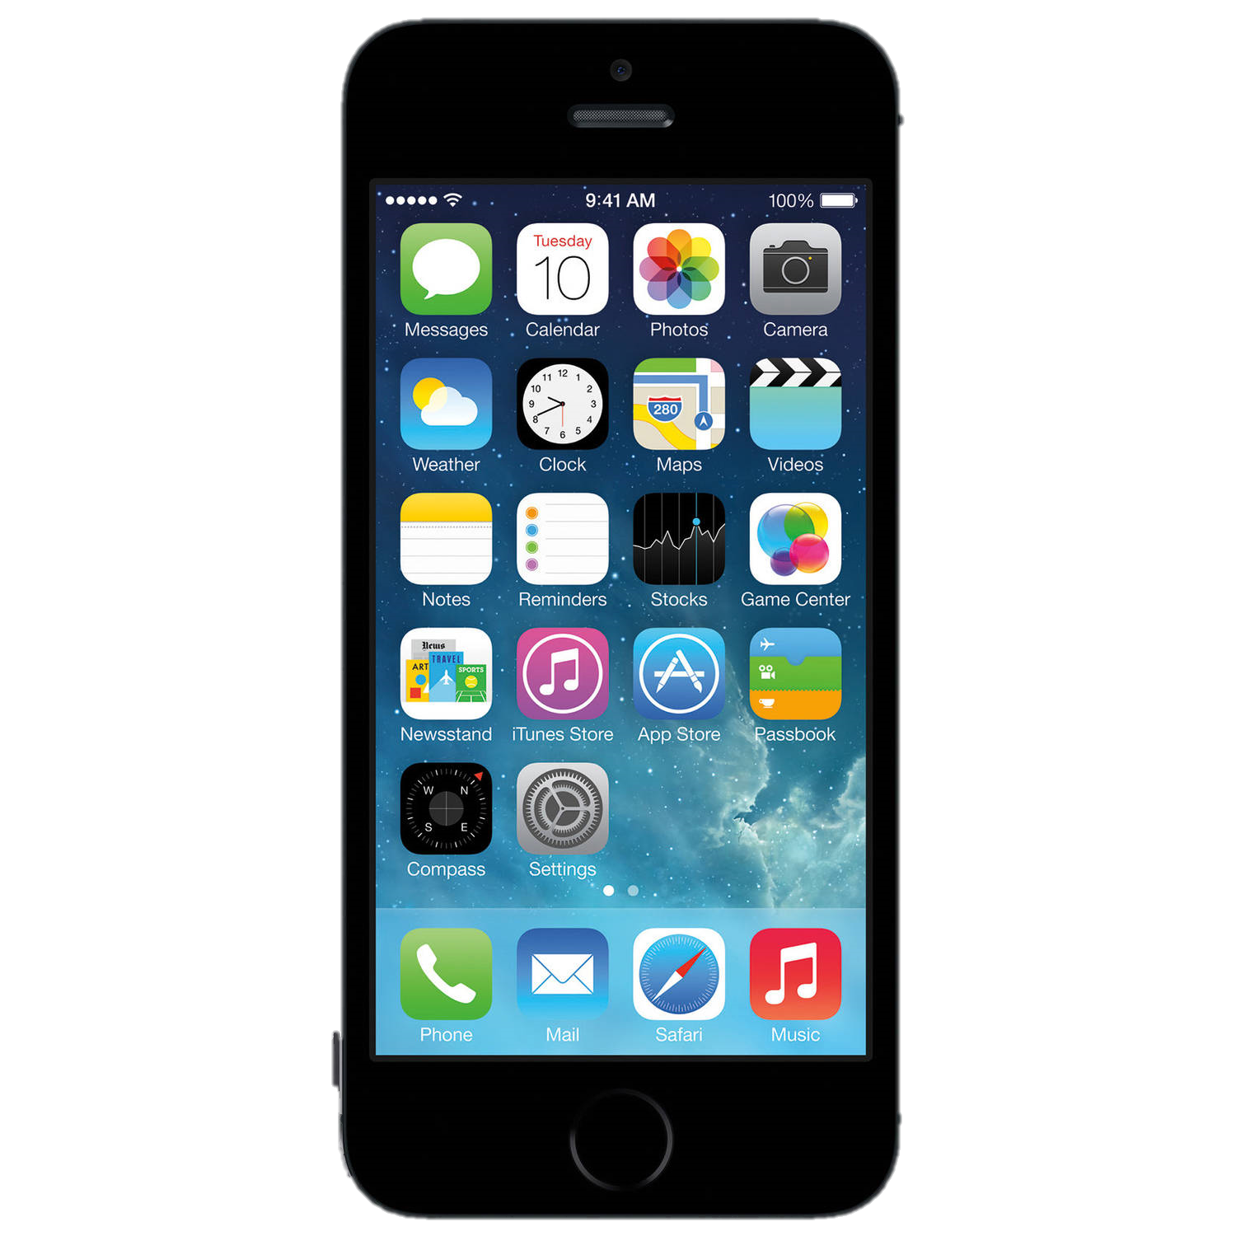
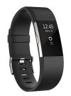
IT Operations Conundrum. “deliver more with less”
Demand for Bandwidth
5 EB/month to 88.7 EB/month
Connected Devices
500 M to 12.6 B
3.64
Number of Apps
continues to increase
Avg person owns 3.64 connected devices.
AI
13x
Smart devices generate 13x more traffic than a non-smart devices.
IT Teams
Flat to Down Headcount
2

Slide 3
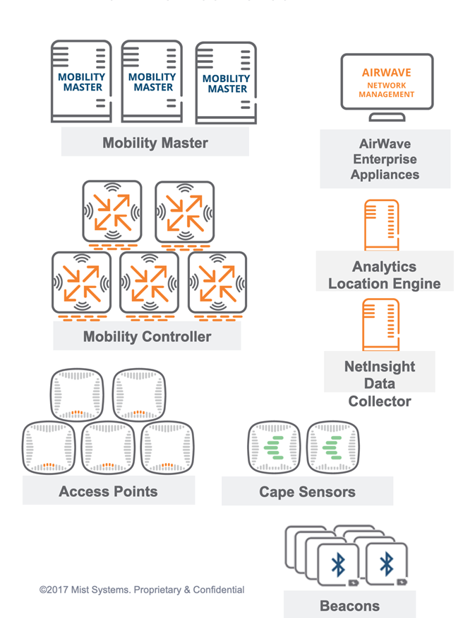
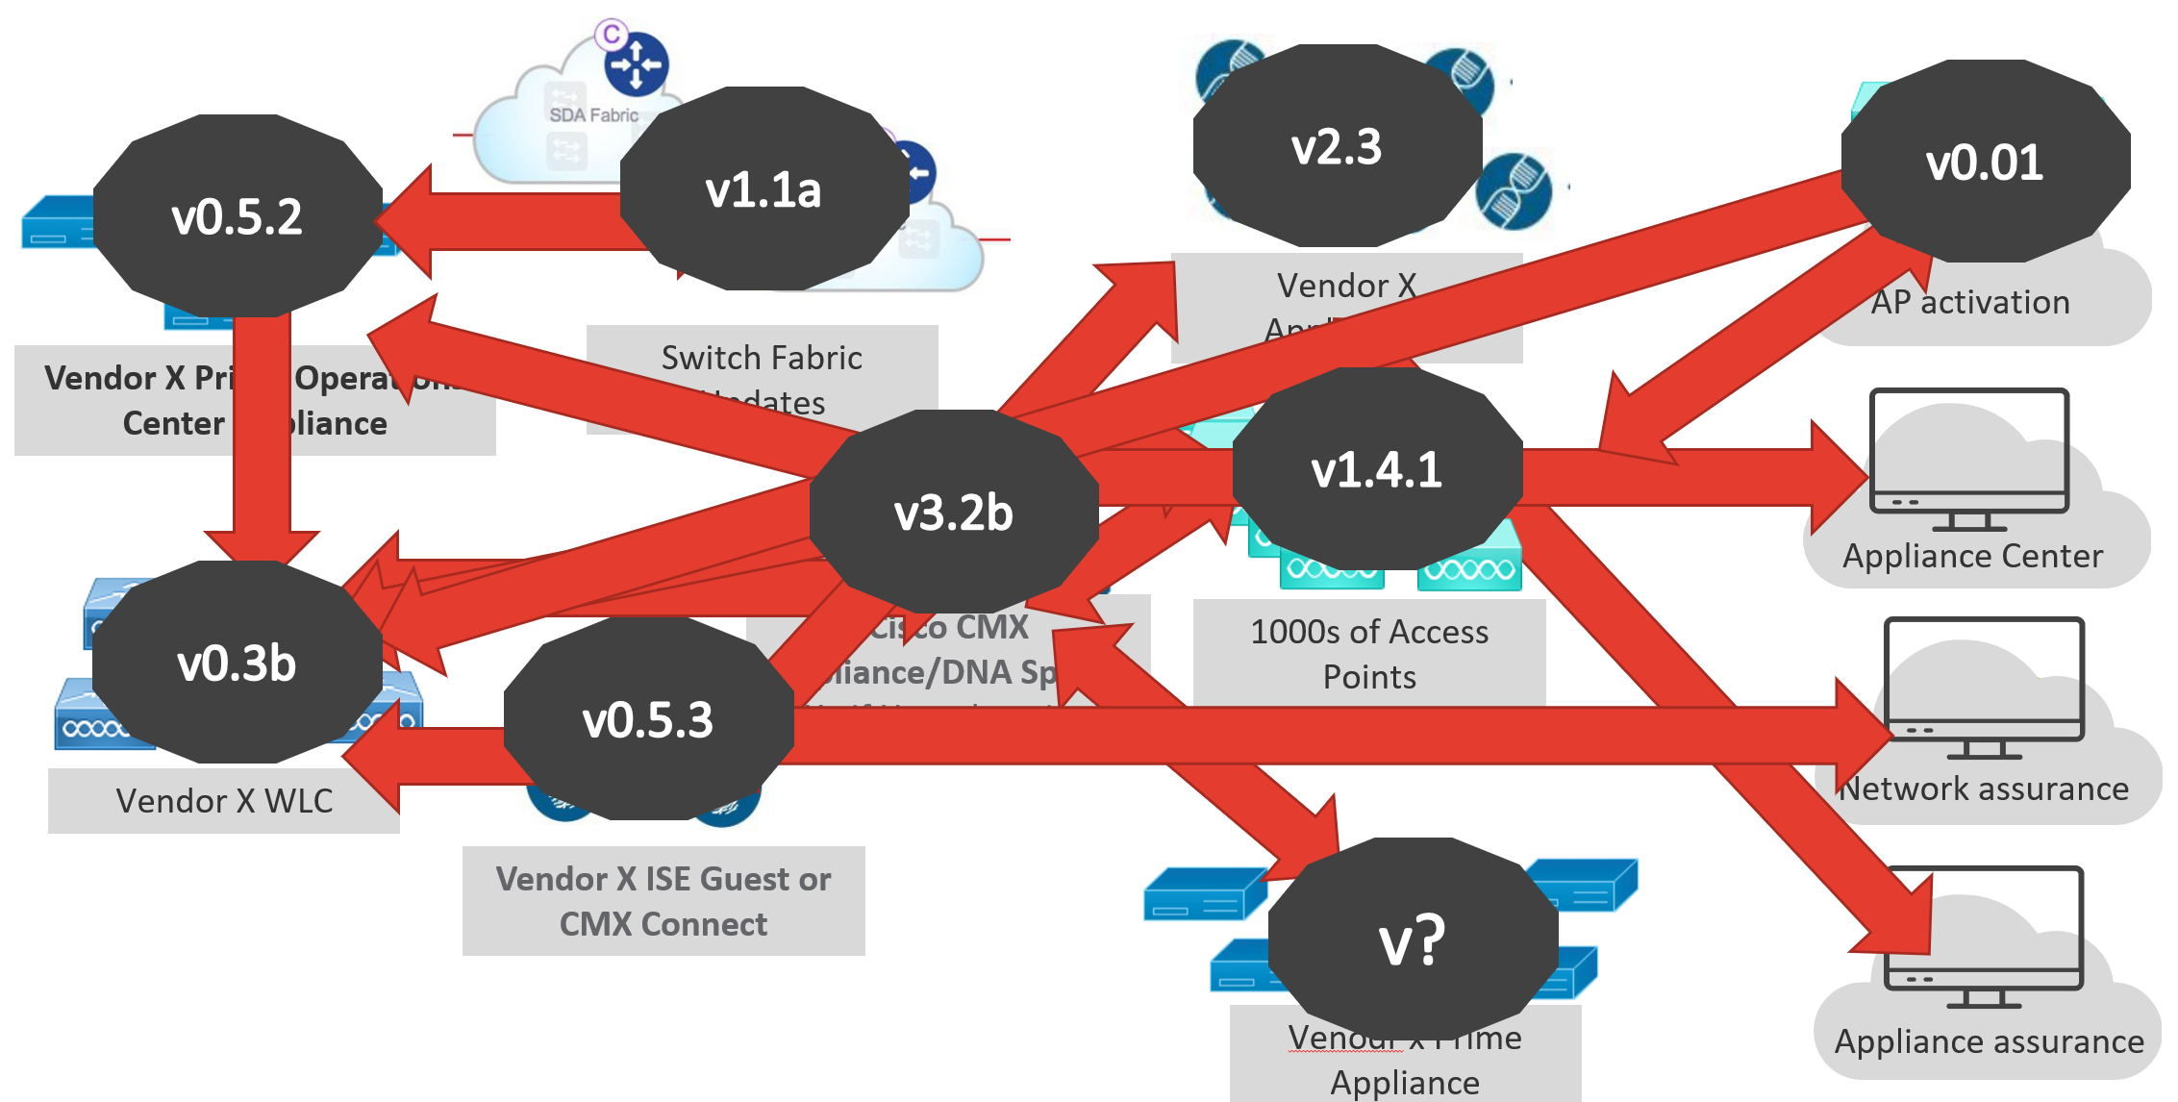
Complexity is the Enemy of Efficiency
On Premise Boxes
Different Clouds
Too Many Dependencies
Controller Master
Appliance Monitor
Cloud Provisioning
Analytics Engine
Location Monitor
Controllers
Data Collector
Access Points
Sensors
Performance Monitor
Beacons
Dashboard Monitor

Slide 4
Cost of Wi-Fi Trouble Tickets in Legacy Networks
User complains Wi-Fi is slow in Student Union
Check client status and status of the Student Union
Is client configured correctly?
What is the MAC address?
Access points down?
Any recent changes like construction?
Any firmware updates to the controllers?
Any client pushes or updates via GPO? (Group Policy object)
Check client wireless MAC address
Check monitoring system for any possible issues
Check client connect history
Check what areas the device typically associates to
Check radius logs
Check user ID
How many devices is the user using on Wi-Fi?
Call user - Questions to ask:
What device?
What driver?
How often does the issue happen?
Can you reproduce the issue?
Does anyone else have the issue?
Does any of your other devices preform in this same manner?
When did this issue start happening (yesterday, last week, last month)?
Is there a particular time of day the issue happens?
Can you share exactly the location you are having the most problems in?
Is there a particular app in use when you observe the slowness?
Any recent changes to your device that you might think adds to the issue?
What wireless network do you connect to?
Visit the Student Union
Try and reproduce the issue on your device
Observe the user while collecting debugs, logs and frame captures as needed.
Speak to other users in the area specific to their experience
Get an exact build of that device and test

Slide 5
What was wrong with Bob’s Zoom call with his class yesterday?
Wi-Fi
Wired network
WAN
!
Server/cloud
Remote
On-Campus
Client device
Notes:
But none of this can happen in a vacuum.
For automation, insight and Ai-driven actions to deliver maximum results from the client all the way through the cloud (or several clouds), they must be coordinated. More specifically, correlation is required across the WLAN, LAN, WAN, DC and security domains to deliver a cohesive story.
Let us put this into perspective with an example…. One we all can relate with.
Yesterday, Bob’s video call dropped. Why? Was it his wifi? A bad Ethernet cable on his router? The zoom app/server in the cloud data center? His PC? Or his Internet connection?
With end-to-end service levels, event correlation, anomaly detection, and self-driving, you can easily discover that it was the last of these issues – the WAN – and fix it before Bob even knew there was a problem

Slide 6
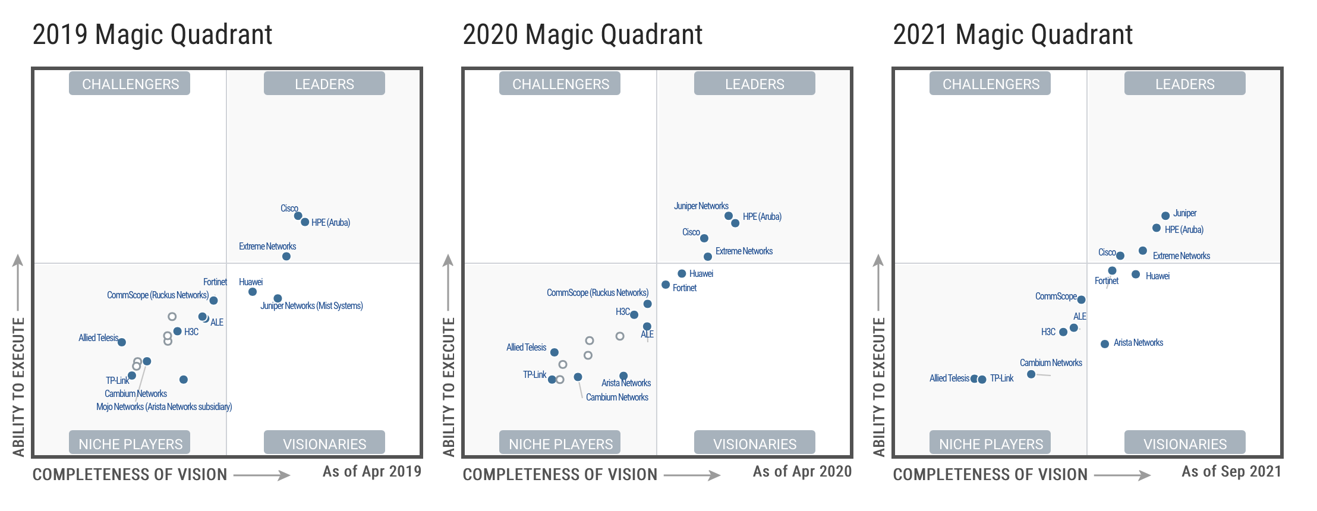
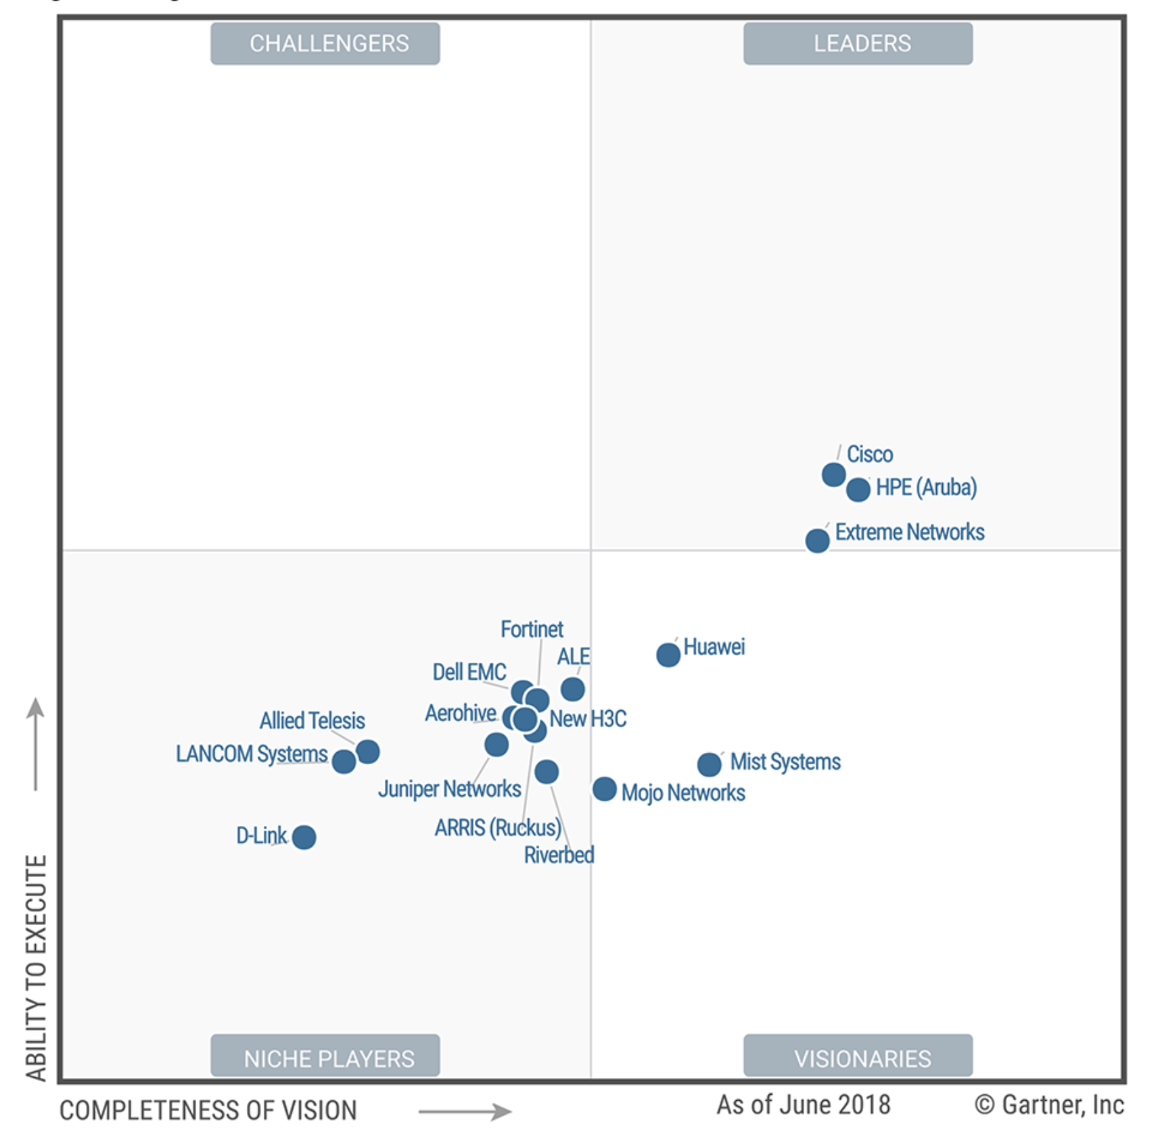
Juniper’s evolution in the MQ
2018 Magic Quadrant
A Visionary!
A Leader!!
THE Leader!!!
Notes:
In 2018, neither Juniper nor Mist were in the ideal positions as standalone companies. Click. In 2019, Juniper acquired Mist, and analysts took note, but also a position of “lets wait and see”. Click. In 2020, when Juniper completed the integration of Juniper switches under the Mist management, and most importantly AI, framework, Gartner surprised the industry by moving Juniper to a very strong position in the leaders quadrant. Click. Late in 2021, Gartner shocked many by placing Juniper in the top position in the industry.

Slide 7
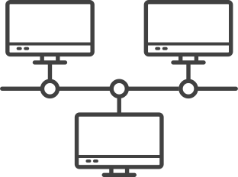
Analyst Recognition
Gartner names Juniper furthest in Vision and highest in Execution
Enterprise Wired & Wireless LAN Infrastructure
Challengers
Leaders
A LEADER
Wired & Wireless LAN Access Infrastructure
Juniper
HPE (Aruba)
Cisco
Huawei
Extreme Networks
Fortinet
Leader
2022 Magic Quadrant
2022 Magic Quadrant
CommScope (RUCKUS)
Arista Networks
Cambium Networks
ALE
Ability to Execute
TP-Link
Niche Players
Visionaries
Completeness of Vision
As of September 2022 ® Gartner, Inc.
7
Notes:
Don’t take our word for it, take Gartner’s.
Juniper has been recognized as the unequivocal leader in the Gartner Magic Quadrant for Wired and Wireless LAN Access infrastructure for three years running. Named the highest in execution and the furthest in vision.

Slide 8
The Only Leader of Both Gartner Magic Quadrants
Enterprise Wired & Wireless LAN Infrastructure
Indoor Location Services, Global
Challengers
Leaders
Challengers
Leaders
Juniper
Cisco
Zebra Technologies
HPE (Aruba)
HID Global
Ubisense
Cisco
STANLEY Healthcare
Inpixon
Juniper
Huawei
Extreme Networks
Cen Trak
AiRISTA
Midmark
Quuppa
CommScope (RUCKUS)
Fortinet
Sonitor
GuardRFID
Arista Networks
Purple
Litum
Cambium Networks
ALE
Ability to Execute
Ability to Execute
TP-Link
Niche Players
Visionaries
Niche Players
Visionaries
Completeness of Vision
As of September 2022 ® Gartner, Inc.
Completeness of Vision
As of February 2022 ® Gartner, Inc.
Notes:
And with Juniper Networks, you get not just one, but two industry leading solutions all managed from the same cloud-based portal and integrated into the same device.
Medical facilities get pervasive and reliable Wi-Fi connectivity with coverage everywhere and highly accurate Indoor Location Services for better personalized experiences and digital engagement.

Slide 9
The Only Leader of Both Gartner Magic Quadrants
Challengers
Leaders
And the only networking company recognized for
Indoor Location
Cisco
Zebra Technologies
Juniper
HID Global
Ubisense
HPE (Aruba)
STANLEY Healthcare
Inpixon
Juniper
Cisco
Cen Trak
AiRISTA
Huawei
Extreme Networks
Midmark
Quuppa
Sonitor
Fortinet
CommScope (RUCKUS)
GuardRFID
Purple
Litum
Arista Networks
Cambium Networks
ALE
Ability to Execute
TP-Link
Niche Players
Visionaries
Completeness of Vision
As of September 2022 ® Gartner, Inc.
Notes:
And if you think this is common, it is NOT.
Juniper is the single networking company recognized for Indoor Location and Wired/Wireless in the entire MQ.

Slide 10
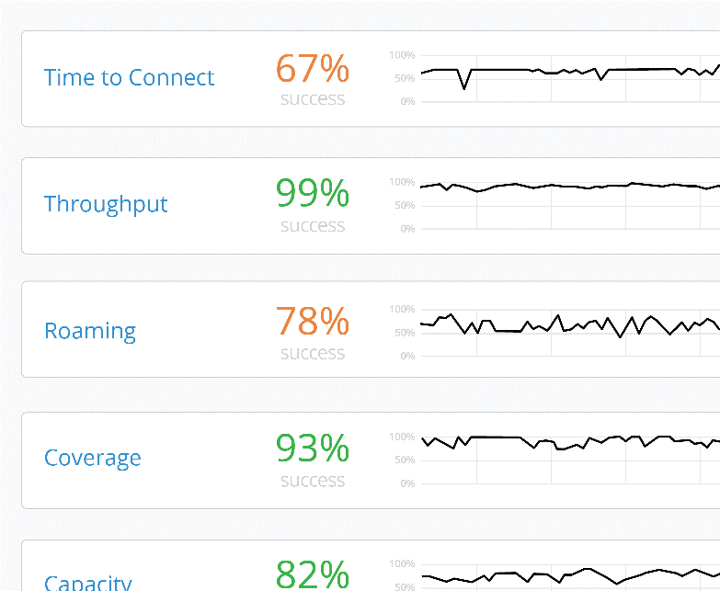
Ai-driven Enterprise
Substantially Better
Key Differentiation
YUM CAFE CUSTOMER
Hi Jeff! Welcome back to Yum Cafe.
Your order is ready for pickup at the counter, see you soon.
Save $2.00
Chicken Fry
Add our signature Chicken Fry sandwich to your order now
$2
Client Level Visibility
AI-driven Operations and Support
Microservices Cloud for Agility
Digital Engagement with Virtual BLE
Underpinned by a 100% Open API driven architecture
Delivered Across the Full Stack
Notes:
Why are the largest and smallest companies moving away from legacy architectures and replacing their networks with Mist? There really are four reasons.
Number one is the user experience. When a device attaches to a network, there are 150 things that can go wrong. The Mist Cloud is tracking every client in real-time and understanding exactly what is happening. That's what allows us to identify an unhappy user proactively before they can call it.
We then couple that information with AI to actually do what a human being would do if they saw what was happening in real-time. We can take packet captures; we can do automated root cause analysis and tell you exactly what is wrong with that client experience, and where in the network it is happening – Wired, Wireless, or WAN.
The third thing is we've eliminated the controller architecture, and move to a modern microservices cloud, which allows us to attain a level of reliability that's never been seen in networking, and at the same time, bring back agility. The fullstack network can evolve at the same rate as the endpoints that attached to it.
And last but not least, we can make the wireless network more relevant to the business. Leveraging Bluetooth technology and a patented antenna array, we can identify people and assets, and we can engage people on their smartphones in the network and provide services that are unparalleled. In a restaurant we can better understand when a customer has, or hasn’t been to a location and present them with personalized offers that can increase brand loyalty, and enhance order size. We can give the business a better understanding of share of wallet.

Slide 11
AI Stories in Higher Education

Slide 12
Higher Ed Institutions are choosing juniper-mist
User Experience
Digital Engagement
Mist is the only vendor in the industry with a cloud built to measure and improve user level visibility
Engage visitors and associates digitally without overlay systems
AI
Microservices Cloud
Mist has the industry’s only Self Driving Network – means fewer tickets and happier users
A modern microservices architecture ensures a network that is easy to operate and agile

Slide 13
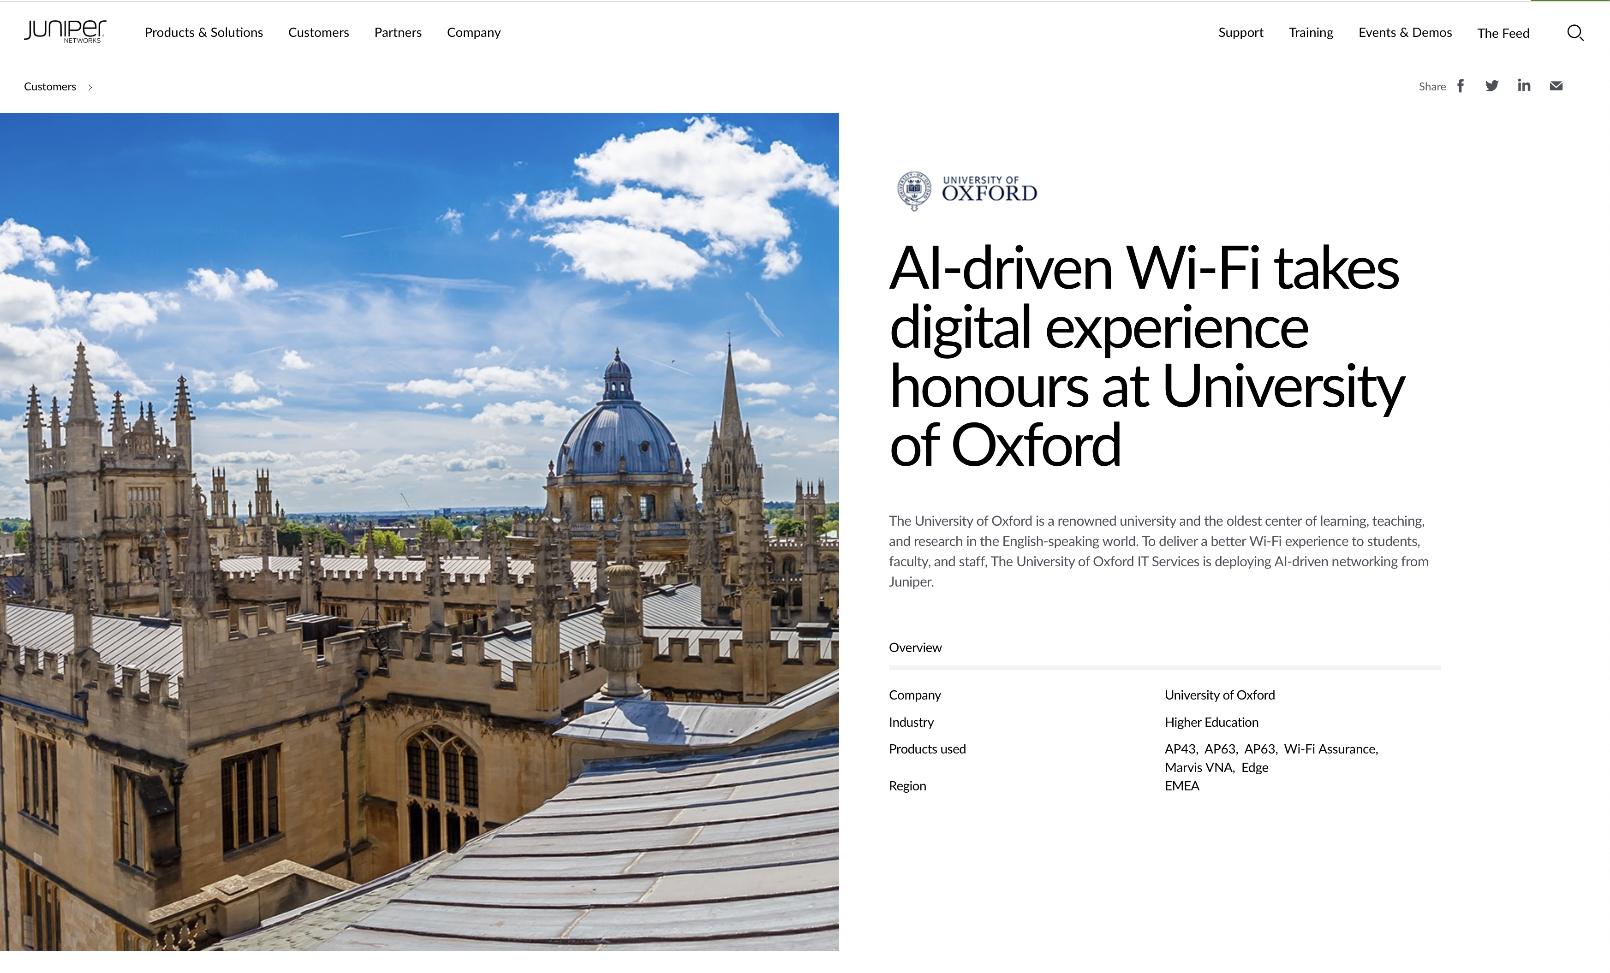
Use case: university of oxford
25,000 students, including 12,510 undergraduates and 13,044 post-graduates
Provide AI-driven Wi-Fi to support central administration, libraries, colleges, and departments
Quickly identify and resolve transient and hidden problems in the network

Slide 14
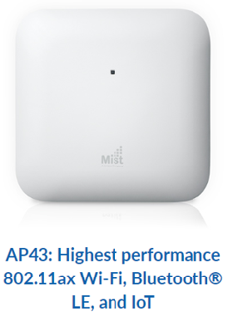
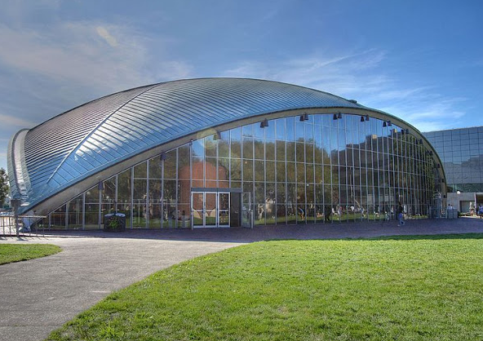
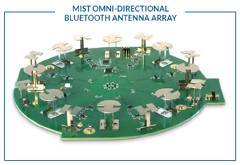
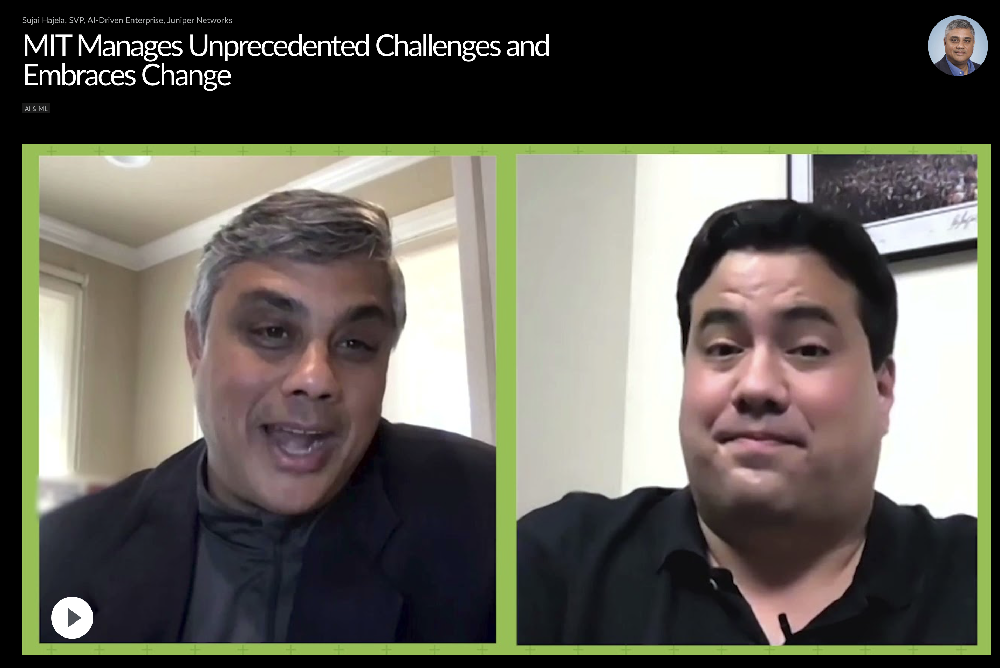
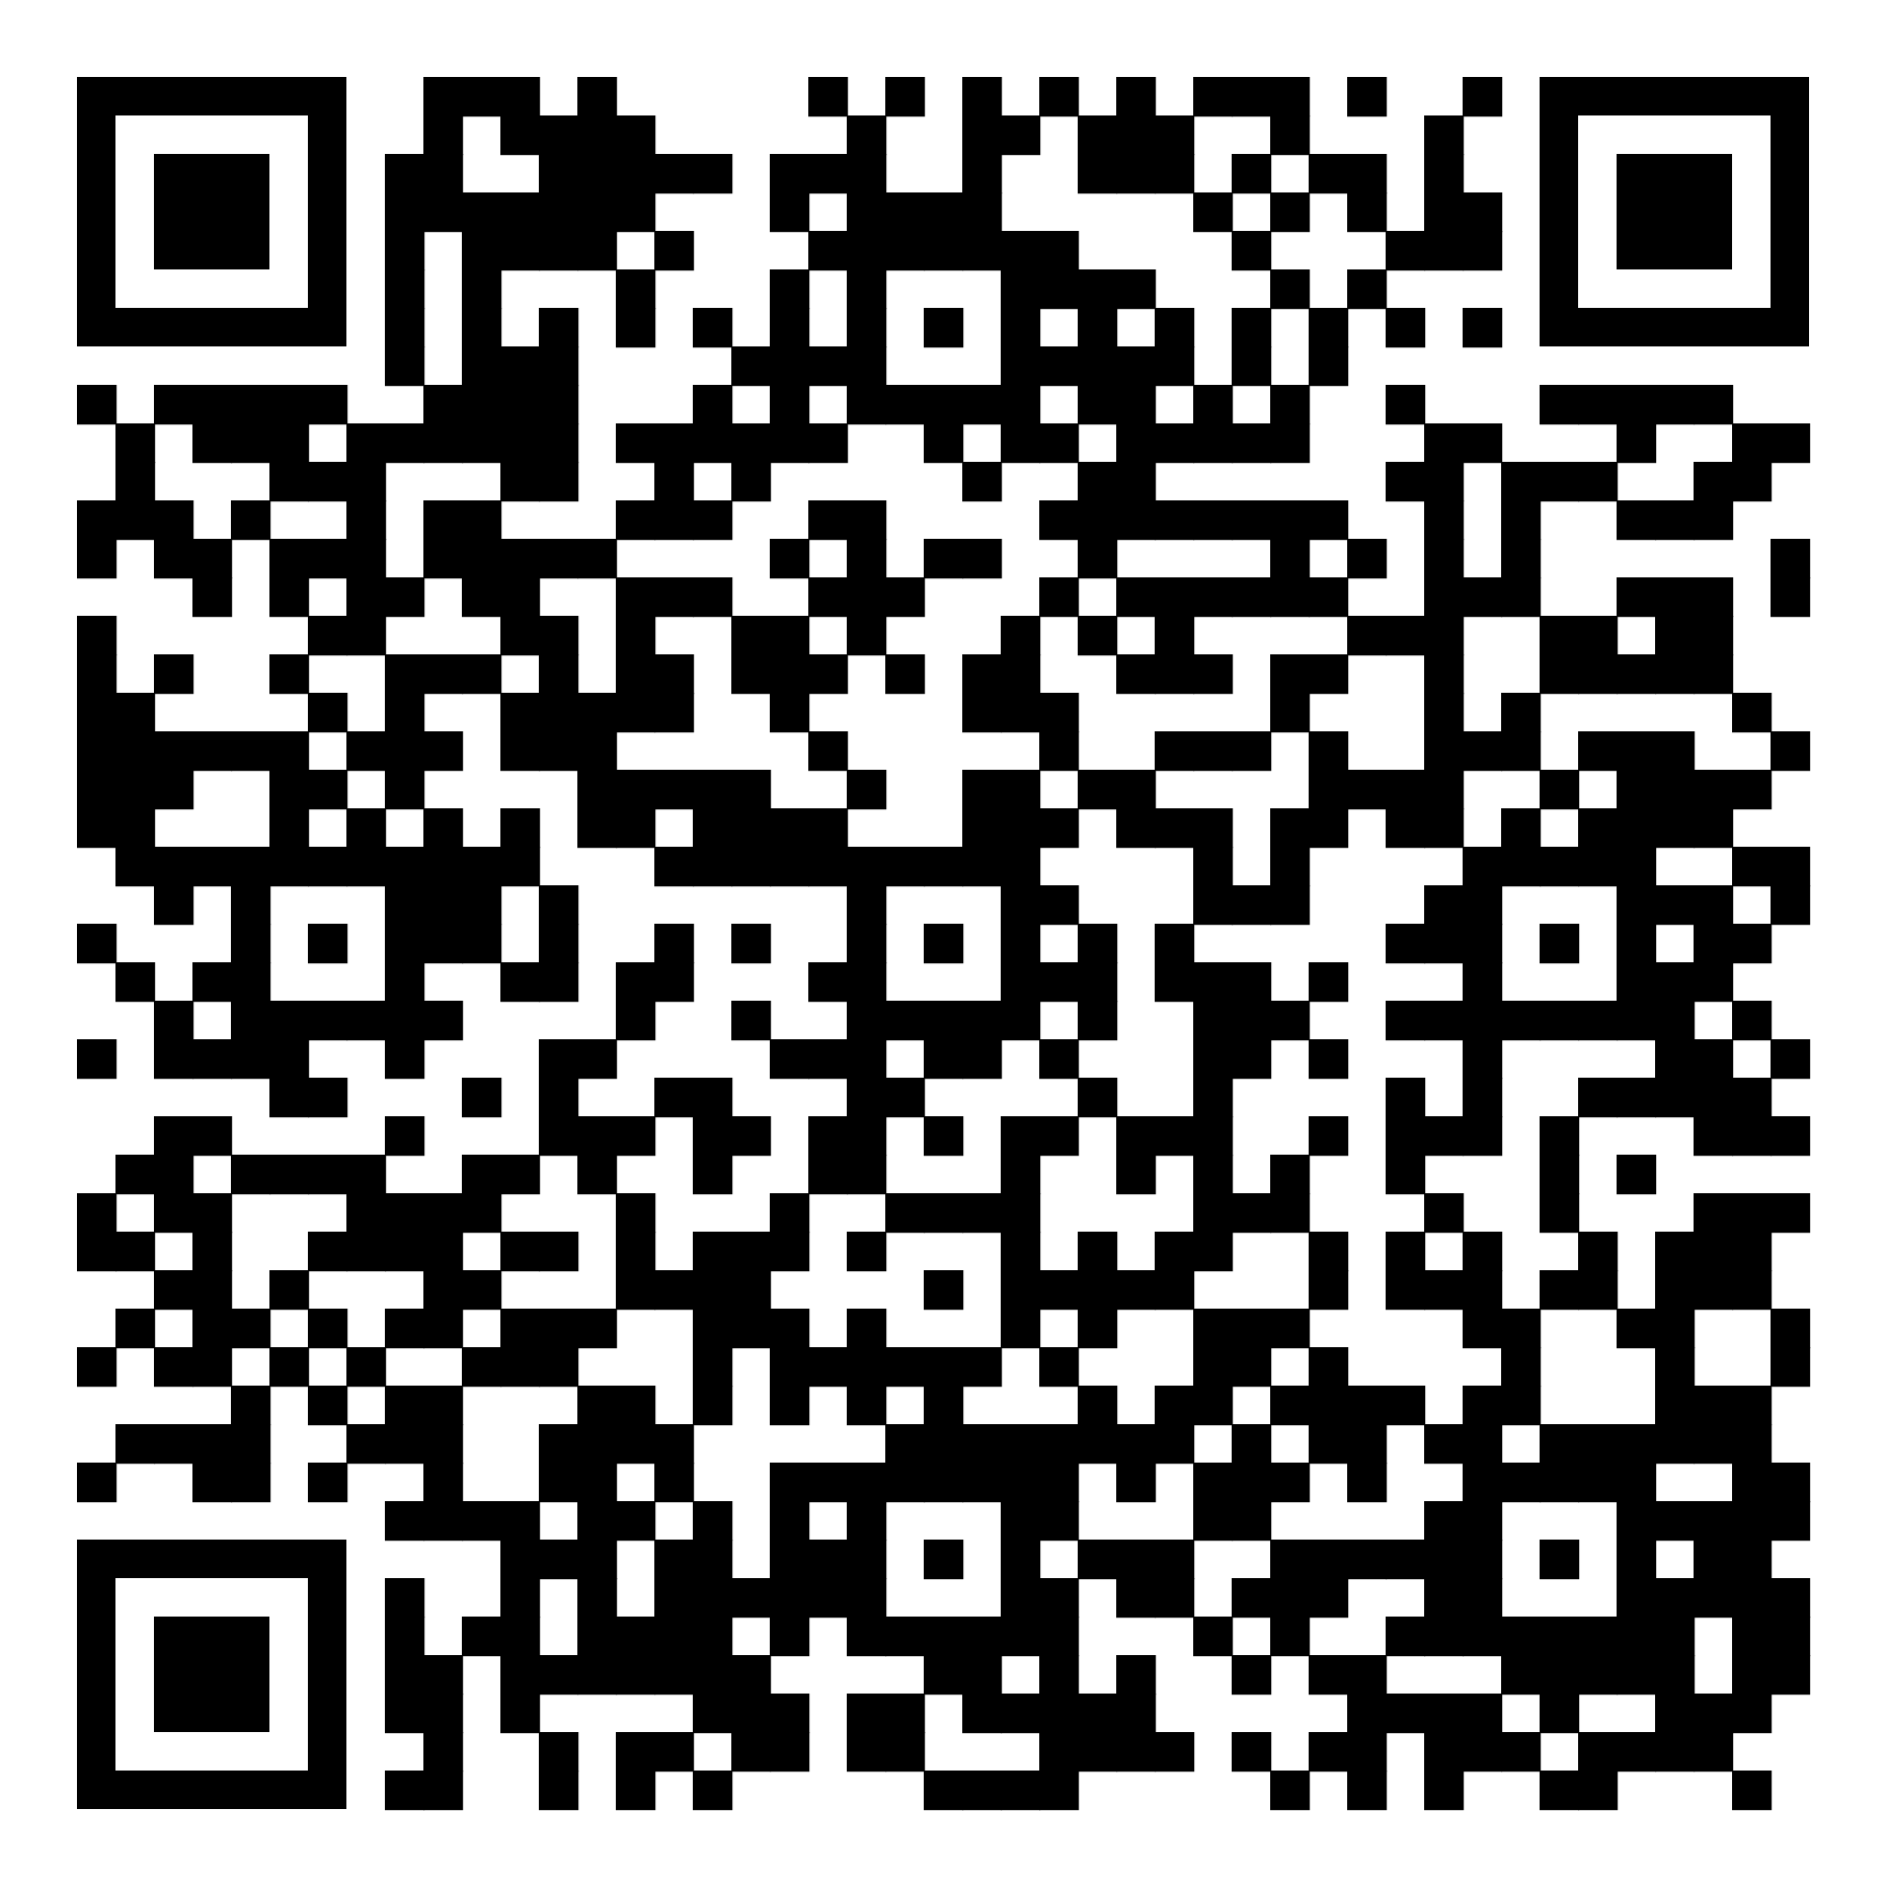
USE CASE: How is MIT Leveraging an AI Driven Architecture?
9,000 AP43 Access Points
Installation in 3 Months
Mist Edge

Slide 15
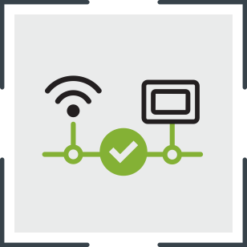
REAL RESULTS
7,000 students and 27,000 devices, all managed by limited IT personnel.
2,000 access points installed in the dorms in less than 48 hours.
Help desk now staffed by grad students.

